Slide 1

Attendance Management System
By
Arun

Slide 2

Agenda
History
Introduction
Why AMS?
Avoid pen-paper hassle
Solve false attendance problem
Give Attendance anytime during class
Missed topics provided
Reports generated for professor
One click attendance
Design and Technical Overview
How the App Works?

Slide 3
History
Classroom Attendance Tracking
Various Methods
Manual on paper/system
RFID Technology
Swiping Student ID Card
Time Clocks (enter Student Id)
Mobile Devices to call the roll(AccuClass Apple)
Barcode scanner from mobile

Slide 4

History
Advantages
(Barcode scanner from mobile):
Hassle free attendance marking scheme
Barcode scanner from mobile
Minimizes false attendance
Cover up on courses
Filtered attendance report, anytime
Full control to professor with administrator options

Slide 5

Introduction
Android app will allow students mark their attendance through a barcode
Will allow the professor record attendance
Will generate a attendance report for professor.
Students can look up missed topics for a particular class.

Slide 6
Why AMS?
Avoid pen-paper hassle
Solve false attendance problem
Give Attendance anytime during class
Missed topics provided
Reports generated for professor
One click attendance

Slide 7

Avoid pen-paper hassle
Papers are difficult to handle and organize
Save trees
Easy lookup

Slide 8

Solve false attendance problem
Each student generates a unique barcode
Device ID is recorded during registration
New barcode is generated with each class

Slide 9
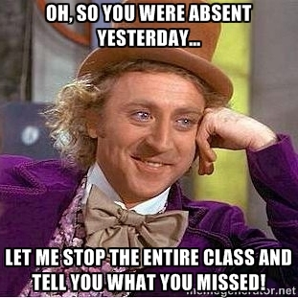
Missed topics provided
Missed class topics and notes (future scope) available to students.

Slide 10

Give Attendance anytime during class
Professor device will scan barcode anytime during the class
Professor is not disturbed during this process

Slide 11

Reports generated for professor
Professor will not have to worry about managing attendance
Can use the time better

Slide 12
Design and Technical
Overview

Slide 13
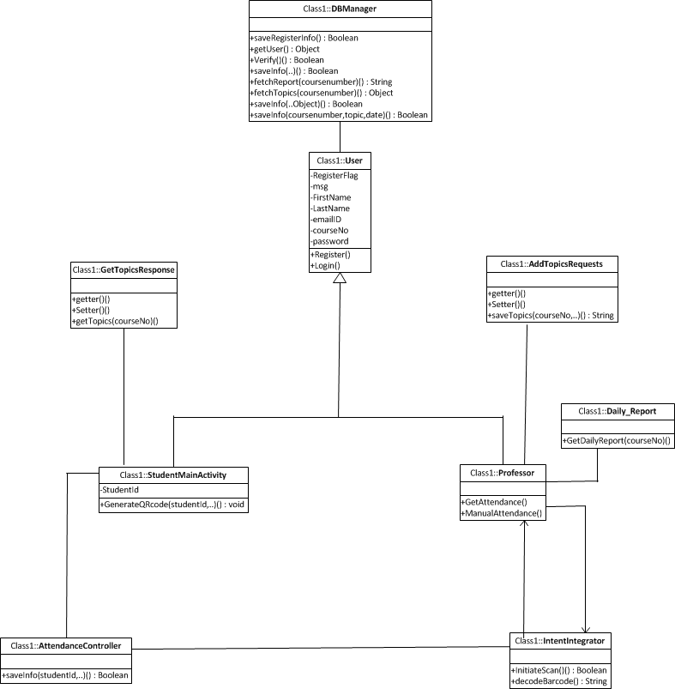
Design Class Diagram

Slide 14
How the App Works?

Slide 15
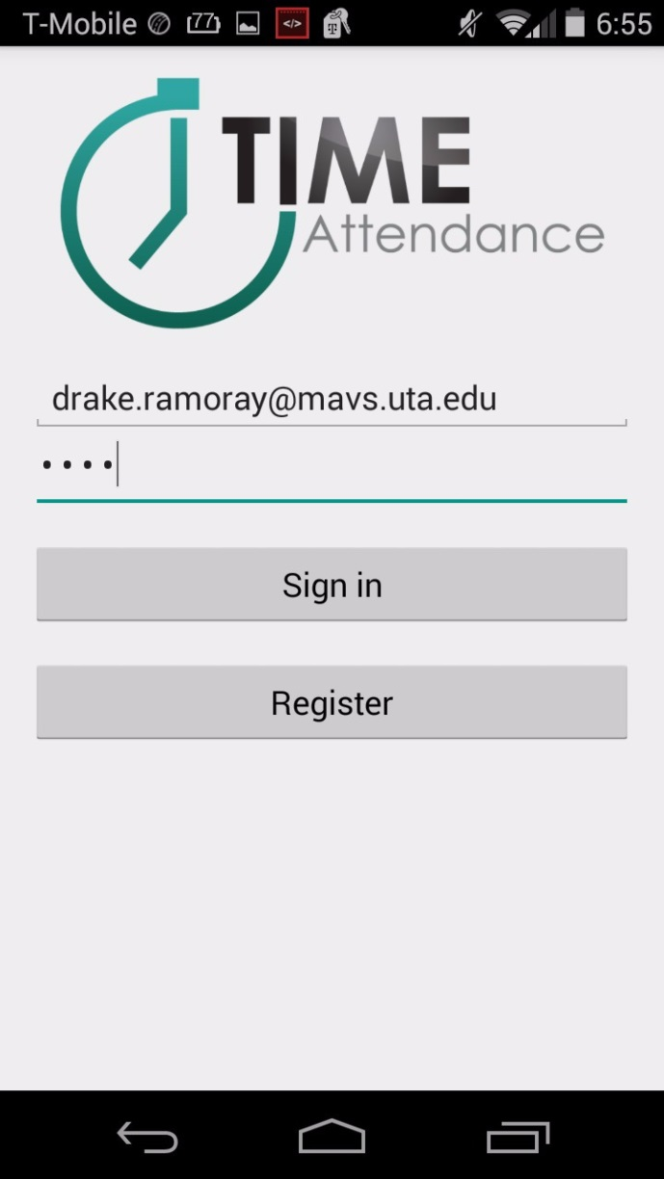
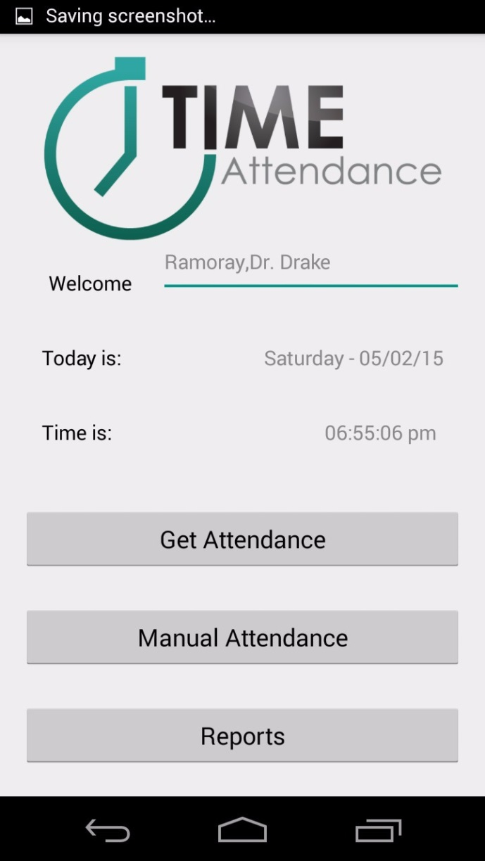
Professor Register/Login

Slide 16
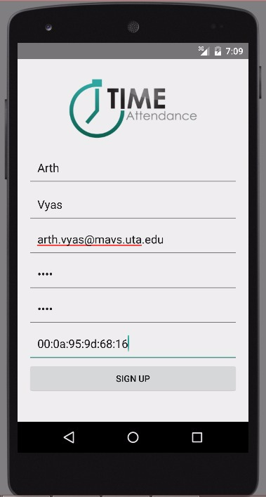
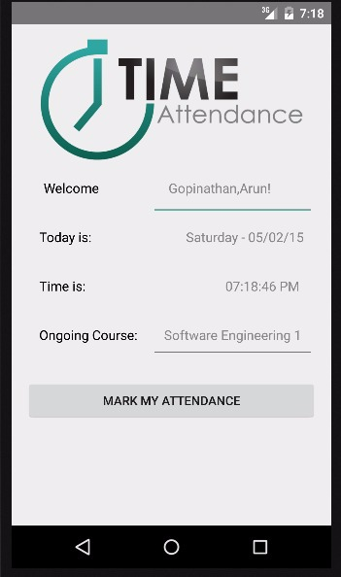
Student Register/Login

Slide 17
Mark Attendance
Date and time – Auto detected
Ongoing course detected through date and time
Clicking on “Mark my Attendance” button produces the barcode.

Slide 18
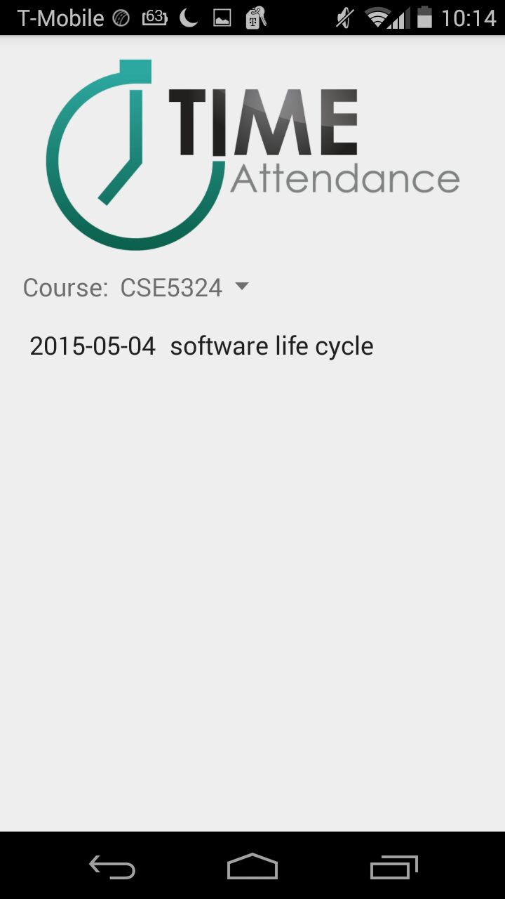
View Missed Topics

Slide 19
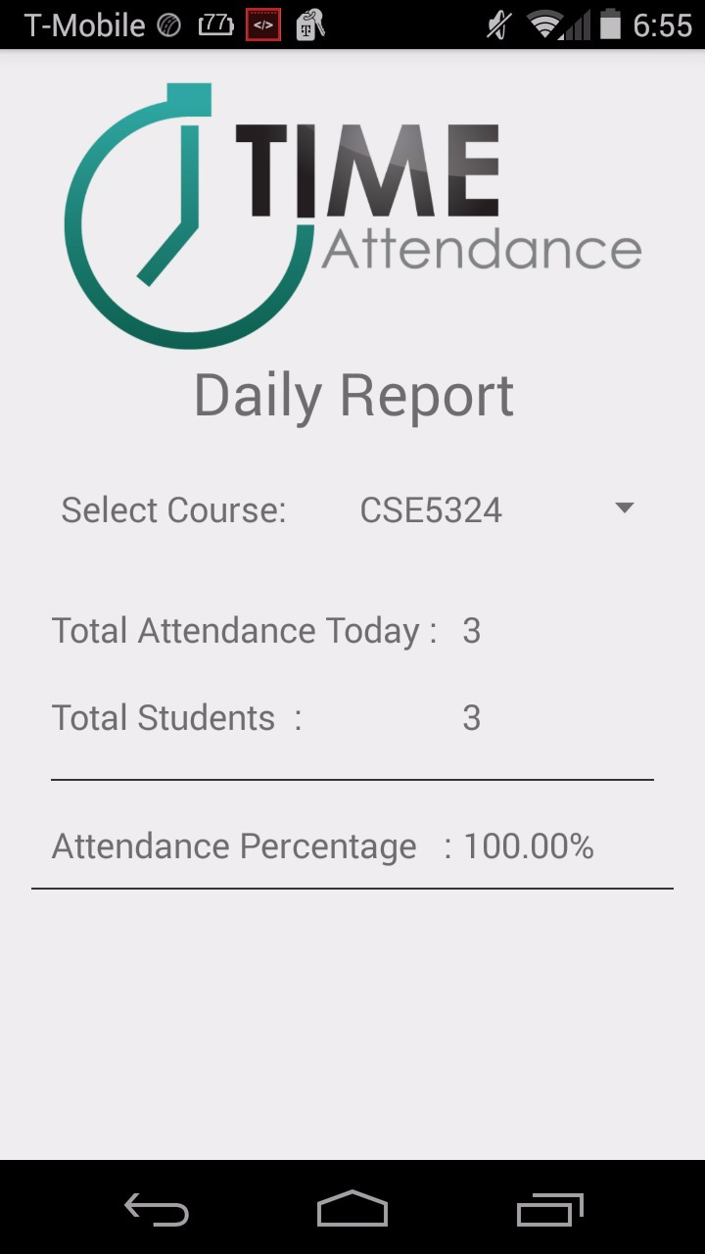
Professor Reports

Slide 20
THANK YOU Good Luck for Finals!

